Slide 1
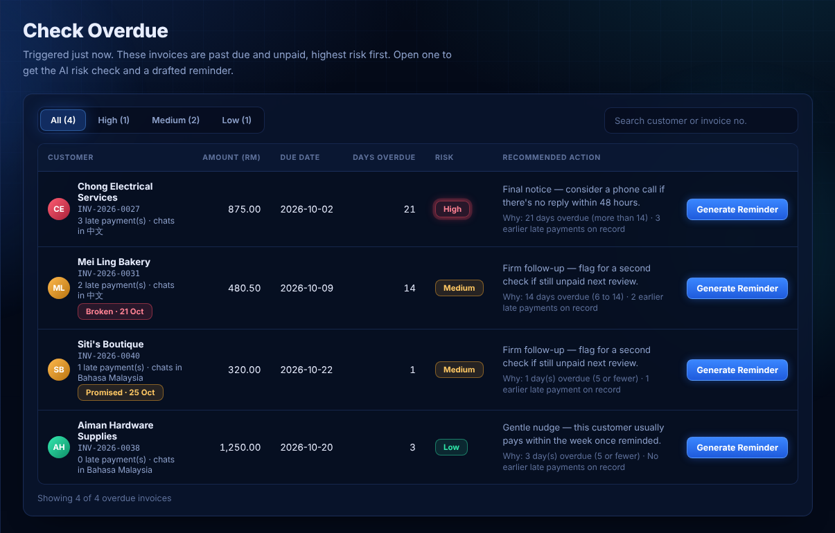
ChaseFlow
SDC HACKATHON 2026 · DOMAIN 2
for Orbyte
An AI assistant that helps Malaysian SME owners chase overdue invoices. A human approves every message.
Team ZH · Wong Zong Han (solo)
Orbyte Smart SME Challenge · SDG 8
Notes:
Hi, I am John from Team ZH. ChaseFlow helps small business owners get paid on time, without hurting customer relationships. I will show the problem, the product, how AI is used safely, and the impact we can measure. All data in the demo is synthetic.

Slide 2
Slow-paying customers squeeze the businesses that employ almost half of Malaysia
THE PROBLEM
39.5%
48.7%
65 vs 57
of Malaysia's GDP comes from MSMEs
of jobs are in MSMEs
average days to pay: SMEs vs large corporations (Jan–May 2024)
The 65-day figure measures how long invoices take to be paid, not how many are late. It shows the cash-flow gap small firms live with.
Sources: DOSM, MSMEs Performance 2024 (released 31 Jul 2025) · Experian Malaysia, State of Credit, May 2024
Notes:
MSMEs are about 39.5 percent of GDP and 48.7 percent of employment, from DOSM's 2024 report. Experian's data shows SMEs take on average 65 days to get paid, compared with 57 days for large corporations. To be careful: this is time to pay, not lateness. But for a small business, waiting longer means less cash for wages, rent and stock.

Slide 3
The owner is also the bookkeeper, and chasing money keeps slipping
WHO IS AFFECTED
1
2
3
IT GETS FORGOTTEN
THE TONE IS HARD
IT TAKES TIME
No one tracks who is overdue. Follow-up depends on the owner's memory and spare time.
Too soft and it is ignored. Too harsh and a good customer is lost. Every message is a judgement call.
Each customer may prefer English, Bahasa Malaysia or Chinese. Writing it well takes minutes, per message.
Target user: the owner or finance person of a small Malaysian business that invoices customers on credit.
Team ZH · ChaseFlow for Orbyte
Notes:
Our target user is the owner of a small business, often doing the accounting alongside everything else. I come from accounting, so this problem is close to me. Three things go wrong: chasing is forgotten, the tone is hard to get right, and writing messages in the customer's language takes time.

Slide 4
One click from "who owes me?" to an approved reminder
THE SOLUTION
1
2
3
4
5
Trigger
Data
Decision
Approval
Outcome
Owner clicks Check Overdue
Invoices, customers, past reminders, promises to pay
Rules set the risk tier. AI explains it and drafts the message
Owner edits and approves. Nothing goes out without it
Simulated send, activity log, Promise-to-Pay tracking
Built for the Orbyte challenge with synthetic data. It does not connect to real Orbyte accounts and sends no real messages.
Team ZH · ChaseFlow for Orbyte
Notes:
This is the journey. The owner clicks Check Overdue. The app reads the invoice data. Plain rules decide the risk tier, and AI explains the reason and drafts a reminder. The owner reviews and approves. Then the send is simulated, logged, and any Promise-to-Pay is tracked. Everything uses synthetic data.

Slide 5
A new Orbyte module, not a copy of one
FIT WITH ORBYTE
ORBYTE TODAY (ORGANISERS' LIST)
WHAT CHASEFLOW ADDS
Live: People, Hiring, Work, eSign, Connect
A connected hub for one recurring burden: chasing overdue invoices
Planned: Travel, Insights, Government
Invoice collections is not among them.
Uses customer contact and language data that would come from People and Connect
Reusable by any SME, no training needed
Based on the organisers' clarification. The Orbyte link is conceptual: the prototype is styled as an Orbyte module with synthetic data and does not call Orbyte.
Team ZH · ChaseFlow for Orbyte
Notes:
The brief asks for something new that plugs into Orbyte, not a copy of a module. From the organisers' list, Orbyte's live modules are People, Hiring, Work, eSign and Connect, and invoice collections is not one of them. ChaseFlow would be a connected hub that reuses customer contact and language data. To be honest, the integration is conceptual here: we did not connect to a real Orbyte account.

Slide 6
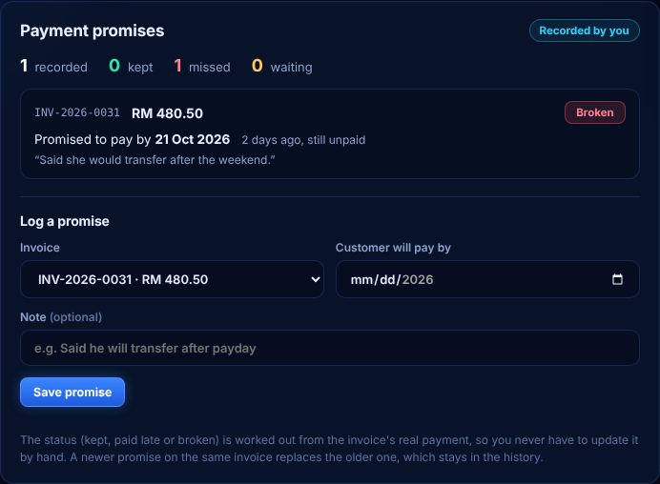
See who is overdue, and what they promised
THE PRODUCT
Promise-to-Pay: status worked out from the invoice's recorded payment
Check Overdue: invoices ranked by risk tier
Screens from the working prototype · synthetic data only
Notes:
Left is the Check Overdue screen: every unpaid invoice with a risk tier. Right is the Promise-to-Pay panel. When a customer says they will pay by a date, the owner logs it. The app works out whether the promise was kept, paid late or broken from the invoice's recorded payment, so nobody updates it by hand. All names and amounts are synthetic.

Slide 7
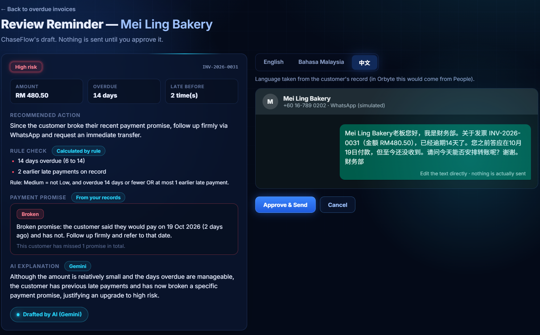
Rules first. AI second. A human approves.
WHERE AI HELPS, AND WHERE IT DOES NOT
RULES (NO AI)
Baseline risk tier and promise status
AI (GEMINI)
May move the tier by one level, must explain why. Drafts in English, Bahasa Malaysia or Chinese
SAFETY
Output validated · human approves · send is simulated · fixed template if AI fails
A real Gemini draft, ready for the owner to edit
Gemini Flash-Lite via the Gemini API · one retry, then cached or rule-based fallback
Notes:
This is where AI adds value, and where we deliberately do not use it. Plain rules give the baseline risk tier, so the result is predictable. Gemini can move the tier by one level and has to explain why, and it writes the reminder in the customer's language and tone. Its output is checked, the owner approves every message, and sending is simulated. If Gemini fails, the app retries once, uses a cached draft, then a fixed template, so the demo never breaks.

Slide 8
A small stack one person can build, run and explain
ARCHITECTURE
Owner
→
Flask app
→
Gemini API
Browser, Jinja2 pages
Routes, rules, approval, activity log
Explanation and draft, JSON output
Synthetic data
Fallback
Hosting
In memory, resets on restart
Retry once, cache, then template
Replit Autoscale, GitHub (Apache-2.0)
Python 3.11 · Flask 3.1 · Jinja2 · requests · Gemini Flash-Lite · 13 automated unit tests
Team ZH · ChaseFlow for Orbyte
Notes:
The architecture is deliberately simple. A Flask app serves the pages, applies the rules, and keeps the activity log. It calls the Gemini API for the explanation and the draft. Data is synthetic and kept in memory. If Gemini fails, there is a fallback. It runs on Replit, the code is on GitHub under Apache 2.0, and there are 13 automated tests.

Slide 9
We measure the time saved per reminder, and name what is still an assumption
IMPACT · SDG 8, TARGET 8.3
BASELINE
OUR KPI
PHASE 2 TARGET
65 days
minutes
≥ 80%
SME average time to pay (Experian, Jan–May 2024)
per reminder, from overdue invoice to approved message
less time per reminder, tested in a pilot
Assumption, not yet measured: writing a reminder by hand takes about 5 minutes. Closing the gap from 65 toward 57 days is a long-term aim, not a claim we make for Phase 2.
Sources: Experian Malaysia, State of Credit, May 2024 · UN SDG 8, Target 8.3
Notes:
Our SDG link is Target 8.3, supporting growth of micro, small and medium enterprises. The baseline is Experian's 65-day average time to pay. Our own KPI is minutes per reminder. I want to be clear that the 5 minutes by hand is an assumption, not a measured number, and the 80 percent reduction is a Phase 2 target to test in a pilot. Moving from 65 toward 57 days is a long-term aim, and I do not claim ChaseFlow achieves it now.

Slide 10
The hardest risk is a bad AI answer, so the design assumes it will happen
FEASIBILITY AND RISK
HARDEST RISK
FALLBACK
A wrong risk tier or an unsuitable draft, or Gemini being slow or down.
Rules set the baseline. Output is validated. One retry, then a cached draft, then a fixed template. The owner approves everything.
DATA AND PDPA
OUT OF SCOPE
Demo uses synthetic data only. Real customer data would need consent and PDPA-compliant handling first.
Real payments, real messages, legal or financial advice, and any real Orbyte connection.
Team ZH · ChaseFlow for Orbyte
Notes:
The hardest risk is the AI being wrong or unavailable. So rules come first, the AI output is validated, there is one retry then a cache then a fixed template, and a human approves every message. On privacy: the demo uses synthetic data only. With real customer data we would need consent and PDPA-compliant handling. Out of scope: real payments, sending real messages, legal or financial advice, and a real Orbyte connection.

Slide 11
Safe, simple and made for Malaysian SMEs
WHY CHASEFLOW STANDS OUT
1 · Rules first, AI second
2 · Human in control
3 · Speaks the customer's language
Predictable risk tiers. AI only explains and drafts.
The owner approves every message. Sending is simulated.
English, Bahasa Malaysia or Chinese, from the customer record.
4 · Promise-to-Pay
5 · No training needed
6 · Honest numbers
Kept, late or broken is worked out from the invoice's recorded payment.
One click from overdue list to a ready draft.
One clear KPI, and assumptions are labelled.
Built by an accounting student with a long-standing interest in SME problems.
Team ZH · ChaseFlow for Orbyte
Notes:
Six reasons this stands out. Rules first and AI second keeps results predictable. The owner stays in control. Messages match the customer's language. Promise-to-Pay status comes from the recorded payment. It needs no training. And we are honest about what is measured and what is assumed. I am an accounting student and I have long been interested in SME problems, which is why I chose this one.

Slide 12
Get paid on time.
Keep the customer.
NEXT STEPS
1
Pilot with a few SMEs using their own data, with consent, and measure minutes per reminder
2
Add a database so data survives restarts
3
Explore real sending only after owner approval, and an Orbyte integration if invited
Thank you · Team ZH · Wong Zong Han
github.com/johnwong2403/chaseflow-orbyte
Notes:
To close: ChaseFlow helps small business owners chase payments faster and more politely, with a human always in control. Next we would pilot with a few SMEs using their own data, with consent, and measure minutes per reminder. These are plans, not done work. Thank you.

